Slide 1

Parent Workshop:
Phonics and Reading
2026

Slide 2


Little Wandle Letters and Sounds Revised
Our school has chosen
Little Wandle Letters and Sounds Revised as our systematic, synthetic phonics (SSP) programme to teach early reading and spelling.

Slide 3
Phonics
‘Little Wandle Letters and Sounds Revised’ is a complete systematic synthetic phonics programme.
Which Year Groups?
Reception, Year 1 and the Autumn term (September – December) of Year 2.
What does it involve?
5 whole class phonics lessons per week
Use of mnemonics, phrases and flashcards
3 reading sessions per week in a group of 6 children
Additional support and reading sessions for those that need it
Reading at home with your support

Slide 4
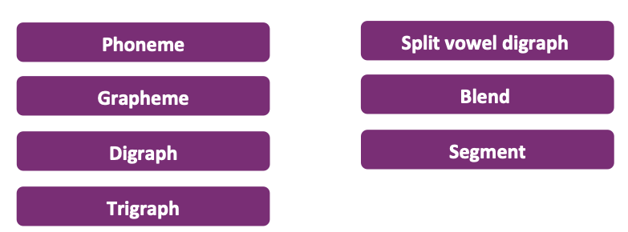
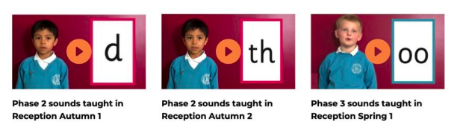
What parents and carers need to know about phonics
Key vocabulary
How to pronounce each sound
Find all these videos and a glossary on:https://www.littlewandlelettersandsounds.org.uk/resources/for-parents/

Slide 5
Parent and Carer Task
How many phonemes in the words...
bake ladder shock bank
How many digraphs in the words...
thanks shower lunch

Slide 6
Parent and Carer Task
Answers
How many phonemes in the words...
bake ladder shock bank
How many digraphs in the words...
thanks shower lunch
3 4 3 3
2 3 1

Slide 7

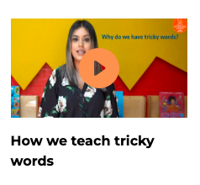
What parents and carers need to know about phonics
How to blend sounds to read words
What tricky words are and how we teach them
Some children learn to blend really quickly, and others take a little longer. If your child is finding it difficult, ask your child’s teacher for ways to help at home.
Find all these videos and support guides on https://www.littlewandlelettersandsounds.org.uk/resources/for-parents/

Slide 8

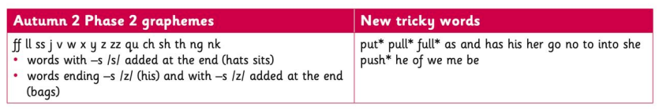
Teaching Order
Weekly
4 new sounds a week
1 day a week for revision
You will get a list of the
sounds that we are learning
to have at home
Progression Map
An overview is available on the Little Wandle website
Example:

Slide 9


Reading and Spelling
This is an example of what the children learn in Year 1.
Children learn that there are graphemes that can have different sounds and sounds that can be made with different letters.

Slide 10
Parent and Carer Task
Can you think of all the different ways to write the phoneme sh?

Slide 11

Parent and Carer Task
Can you think of all the different ways to write the phoneme sh?
Answers

Slide 12
Spelling
1
shop
How we teach children to write...
2
Say the word aloud
Segment the sounds
Count the sounds
Write them down
sh/o/p
3
sh/o/p
1 2 3
4
shop

Slide 13
How we teach reading in books?
Reading practice sessions are:
Timetabled three times a week
    First session on decoding (sounding out words)
    Second session on prosody (reading with expression)
    Third session on comprehension
Taught by a trained teacher/teaching assistant
Taught in small groups, 3 days in a row
A chance to develop fluency

Slide 14

Reading
We use assessment every 6 weeks to match your child to the right level of book

Slide 15

Reading a book
If the book is at the right level your child should:
Know all the sounds and tricky words in their phonics book well
Read many of the words by silent blending (in their head) – their reading will be automatic
Only need to stop and sound out about 5% of the words by the time they bring the book home – but they should be able to do this on their own

Slide 16

Reading at home
YOU MUST RETURN THIS BOOK ON THE MONDAY
Children will bring home a ‘learning to read’ book and a book for sharing with you. They will read the ‘learning to read’ book and you (adult) will read the sharing book.
Please read with your child as often as you can – at least once a day if possible. Make sure to celebrate their success!

Slide 17

Shared book
The shared book is for YOU to read.
Make sure you are all ready to read/listen to a story – relaxed
Make the story sound as exciting as you can by changing your voice.
  Talk with your child as much as you can:
  Introduce new and exciting language
  Encourage your child to use new vocabulary
  Make up sentences together
  Find different words to use
  Describe things you see

Slide 18
Any questions?
Please use the Little Wandle website, it has lots of useful resources for parents and carers.
https://www.littlewandlelettersandsounds.org.uk/resources/for-parents/
If you have any questions please speak to the staff in your class first either in person or send an email to info@kilmorie.lewisham.sch.uk adding FAO of your class teacher.
We will be compiling a list of FAQs and will add these to our school website shortly.

